Slide 1



What is driving home prices?
Factors to identify

Slide 2
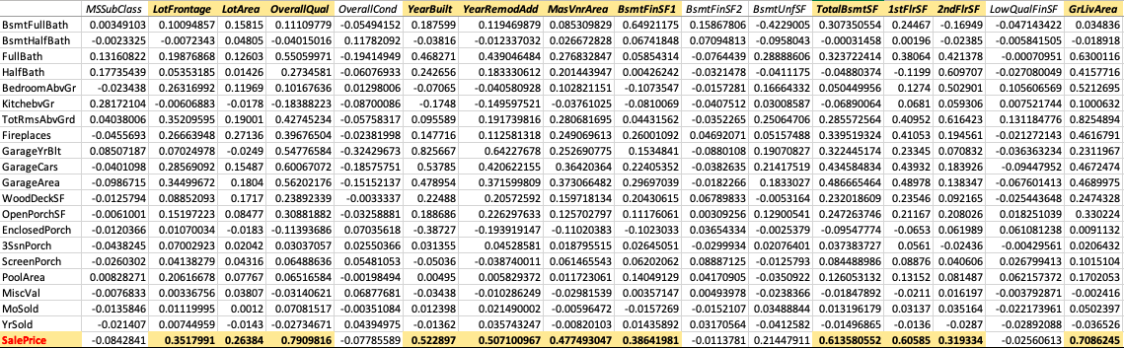
major factors driving home prices

Slide 3
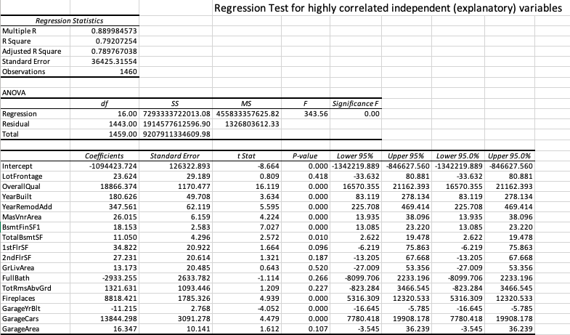
How these influence sale price

Slide 4
Hypothesis testing 1 h0 (null): overall material and finish of the home does not affect the sale price h1(alternate): overall material and finish of the home does affect the sale price
The T-test rejected null hypothesis
higher rating leads to higher sale price

Slide 5
Hypothesis testing 2 h0 (null): the home having central air conditioning does not affect the sale price h1(alternate): the home having central air conditioning does affect the sale price
The T-test rejected null hypothesis
Central air conditioning homes have higher sale price

Slide 6
Further Hypotheses tests’ results
Car Garage Capacity – between 1, 2 and 3 – Higher the better
Number of Fireplaces – between 0, 1 and 2 – Higher the better

Slide 7
Few more
Building Type – between Single Family and Two-family– Single Family better
Lot configuration Type – between Cul-de-sac and Inside– Cul-de-sac better
YearBuilt – Recent years better
Garage Type – Attached versus Detached – Attached better

Slide 8
so, the significant factors...
Overall material and finish of the house, Garage Car Capacity, Number of Fireplaces, Year Built, Central Air Conditioning, Building Type, Lot Configuration, Garage Type.

